Slide 1
Overall Design of the CEPC Injector Linac
Jingru Zhang
On behalf of CEPC linac team
Institute of High Energy Physics, CAS

Slide 2
Outline
1
CEPC layout
2
CEPC linac design
3
CEPC linac key technologies development
4
Summary

Slide 3
CEPC layout
CEPC (Circular Electron-Positron Collider) was proposed by Chinese Scientists in Sep. 2012
It is a Higgs Factory
There will be two detectors in the main ring
The CDR has been official released in Nov 14, 2018
From 2018-2022, finish TDR

Slide 4
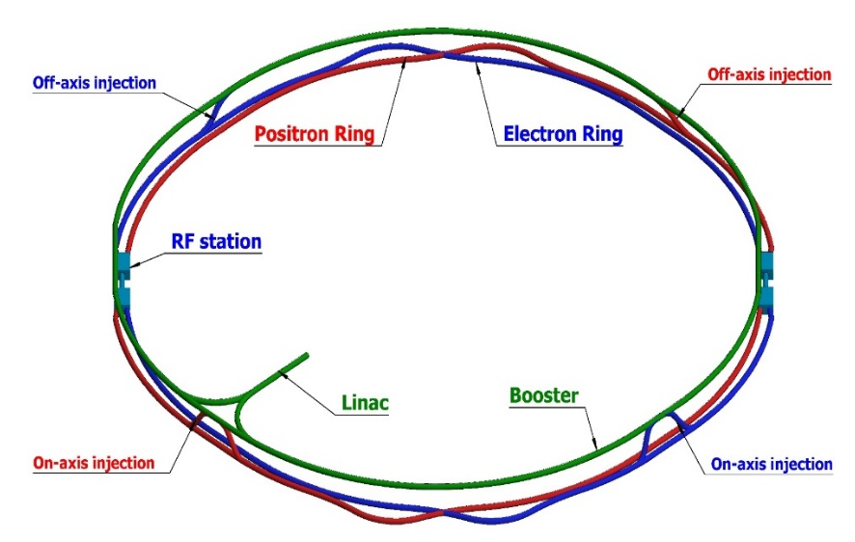
CEPC layout
The circumference of the collider is 100 km (120Gev)
The booster circumference is 100 km.
The total length of the linac is about 1.2 km （10GeV）

Slide 5
Outline
1
CEPC layout
2
CEPC linac design
3
CEPC linac key technologies development
4
Summary

Slide 6
CEPC linac design
The requirements of the booster to the linac
Parameter | Symbol | Unit | Value
e⁻ /e⁺ beam energy | E_{e-}/E_{e+} | GeV | 10
Repetition rate | f_{rep} | Hz | 100
Bunch numbers per pulse |  |  | 1
e⁻ /e⁺ bunch population | Ne-/Ne+ |  | >9.4×10⁹
 |  | nC | >1.5
Energy spread (e⁻ /e⁺ ) | σ_{E} |  | <2×10⁻³
Emittance (e⁻ /e⁺ ) | ε_{r} | nm | <120

Slide 7
CEPC linac design
Linac design goals
  Should provide beams that can meet requirements of Booster
  Top-up injection can be implemented
  Should have the high availability and reliability
    Thermionic electron gun (High charge)
    Normal conducting structures and mature technologies
    ~ 15% backups for linac RF units
  Should have the potential to meet the higher requirements and updates in the future, such as
    Two bunches accelerating mode
    Increasing of charge quantity
    …...

Slide 8
CEPC linac design
Layout of the linac
  Electron linac
  Positron linac
Electron Source and Bunching System
Electron Bypass Transport Line (EBTL)
Section 1
DR
Section 3
PSPAS
(ESBS)
50MeV
4GeV
200MeV
1.1GeV
4GeV
10GeV
  Section 2
Positron Source and Pre-Accelerating Section (PSPAS)

Slide 9
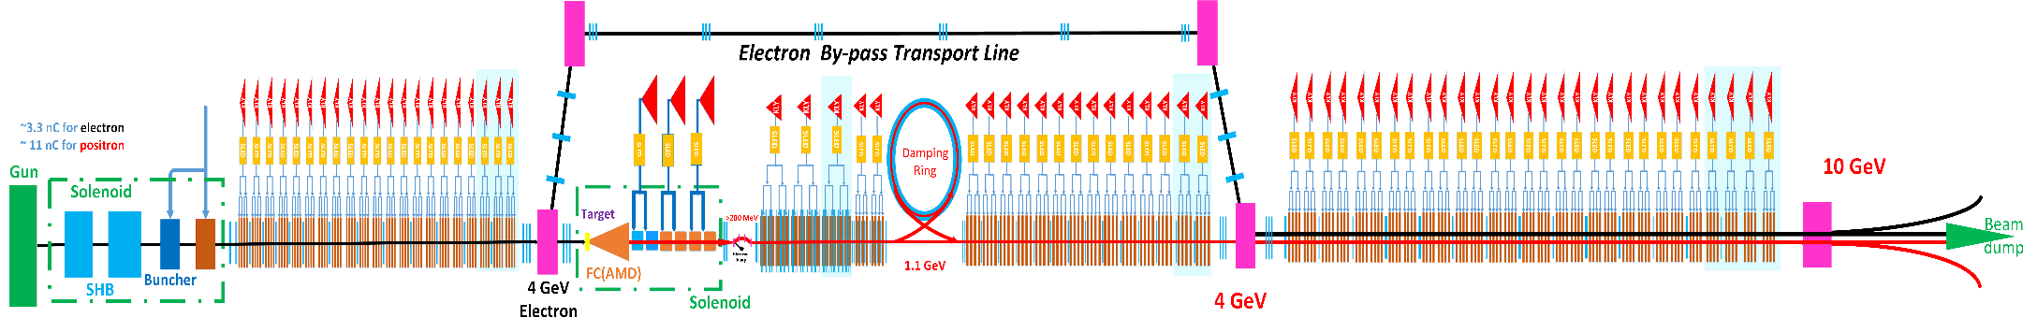
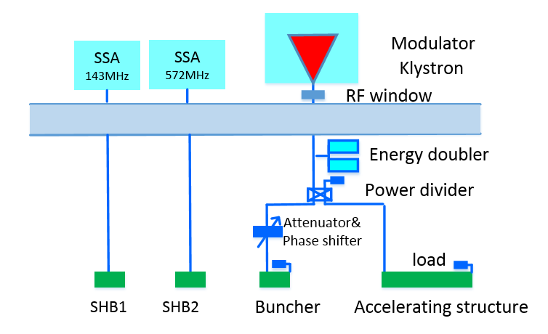
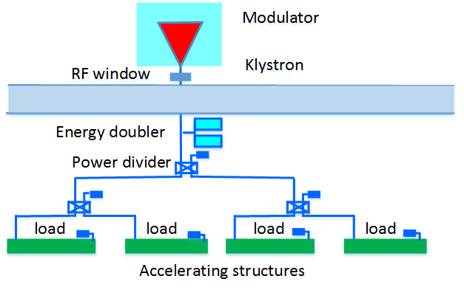
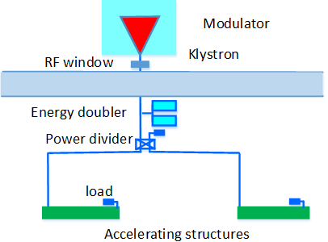
CEPC linac design
80MW klystron

Slide 10
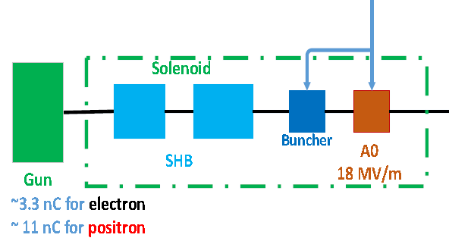
CEPC linac design
S.L. Pei
Parmela
Electron linac (source)
  Thermionic triode electron gun
  Sub-harmonic pre-buncher
    143 MHz
    572 MHz
  Buncher & A0
    2860 MHz
  Emittance
    <100 mm-mrad (Norm.Rms)
  Transmission efficiency
    ~90%

Slide 11
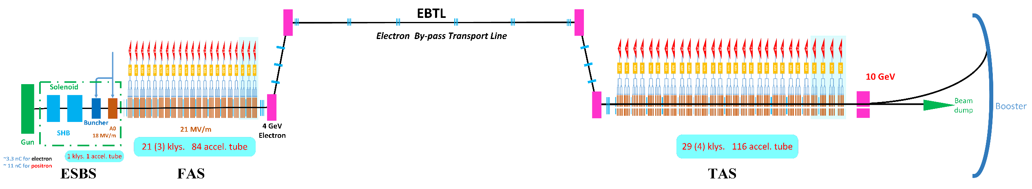
CEPC linac design
Electron linac
Section 1
Section 3
  10 GeV with 3nC charge
  Energy spread (rms): 0.15%
  Emittance (rms): 5nm
C. Meng

Slide 12
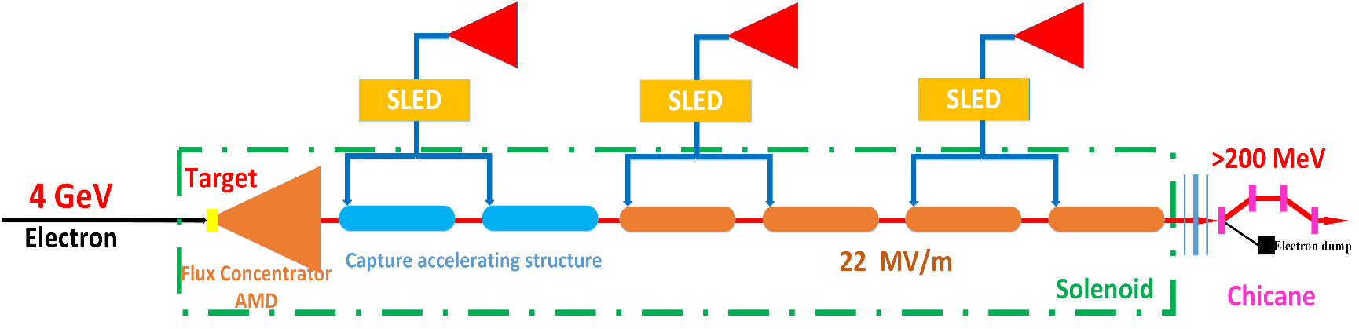
CEPC linac design
Positron linac (Source)
  Target (conventional)
  Adiabatic Matching Device (AMD)
  Capture section
  Pre-accelerating section
  Chicane (Deflecting the useless electrons and photons)

Slide 13
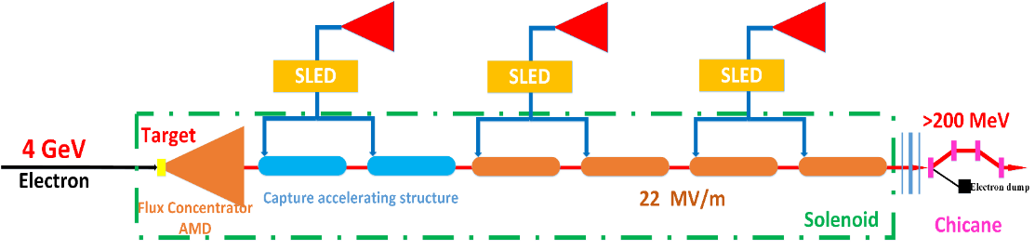
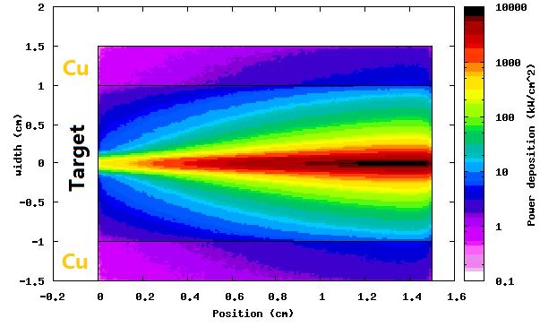
CEPC linac design
Positron linac (Source :Target )
  Electron beam
    4 GeV/10 nC/100 Hz
    Beam size (Rms): 0.5 mm
    Beam power: 4 kW
  Target
    Tungsten
    Thickness 15 mm
  Energy deposition
    0.784 GeV/e- @ FLUKA
    784 W → water cooling
  Support && cooling
    Copper
Notes:
Positron yield

Slide 14
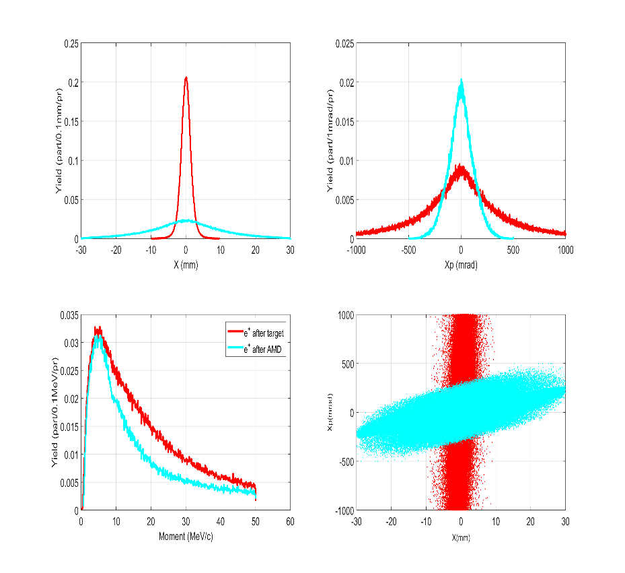
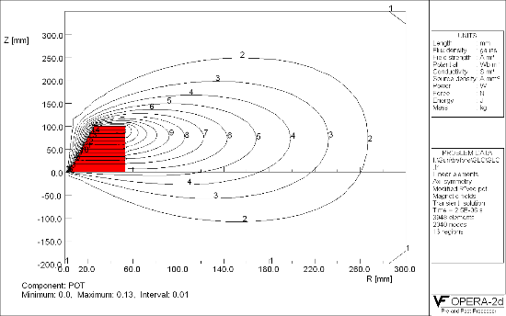
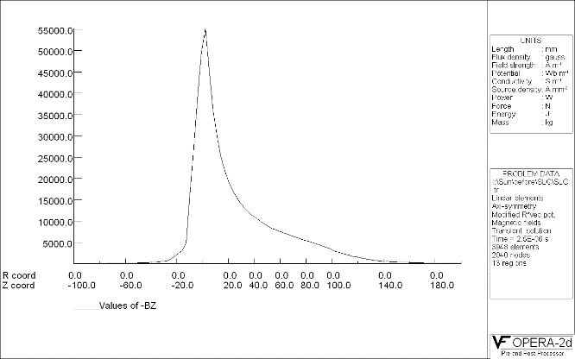
CEPC linac design
Positron linac (Source :AMD)
  Length: 100 mm
  Aperture: 7 mm→52 mm (accelerating structure aperture is 25mm)
  Magnetic field: (5.5 T→0 T) + 0.5 T

Slide 15
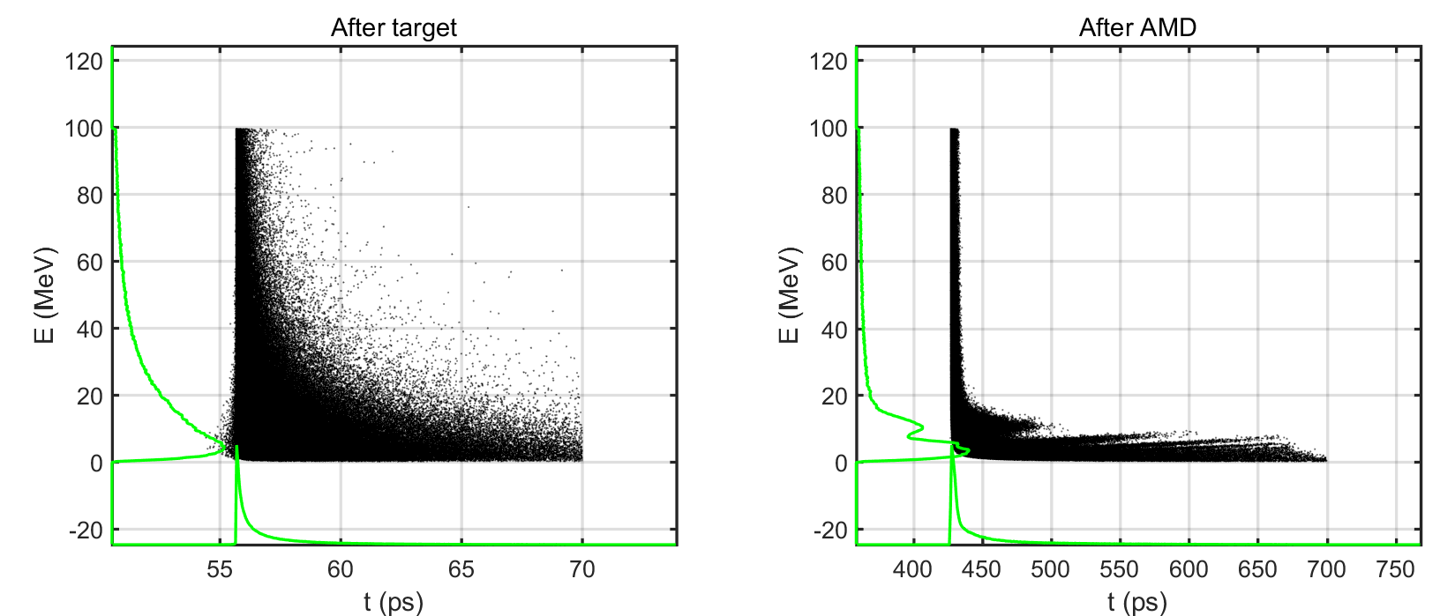
CEPC linac design
Positron linac (Source: AMD)
  Longer bunch length
    Different energy
    Different horizontal momentum
Distribution before and after AMD

Slide 16
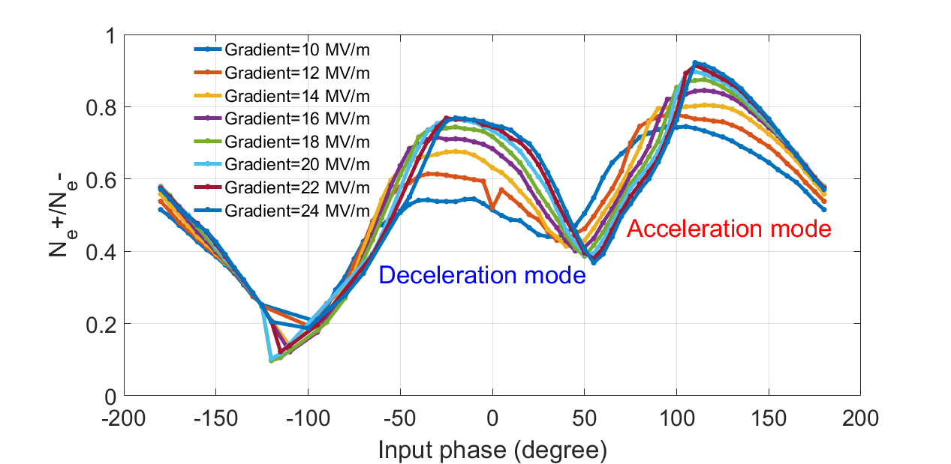
CEPC linac design
Positron linac (Source: Capture section)
  Capture structure
    Length:2 m
    Aperture: 25 mm
    Gradient: 22 MV/m
  The capture RF phase
  Capture efficiency VS. input RF phase

Slide 17
CEPC linac design
Positron linac (Source: Capture section)
  The capture phase
    Accelerating mode
    better moment chip
    small phase spread
  Deceleration mode (D1)
  Acceleration mode (A1)
Distribution of different mode

Slide 18

CEPC linac design
Positron linac (Source: The pre-accelerating structure)
  Different modes have different optimal accelerating phases
  Acceleration mode have higher positron yield
    Stray bunches should be considered
  Deceleration mode (D1)
  Acceleration mode (A1)
Ne+/Ne-[-10°,10°,230 MeV,260 MeV]=0.4
Ne+/Ne-[-8°,12°,235 MeV,265 MeV]=0.55

Slide 19
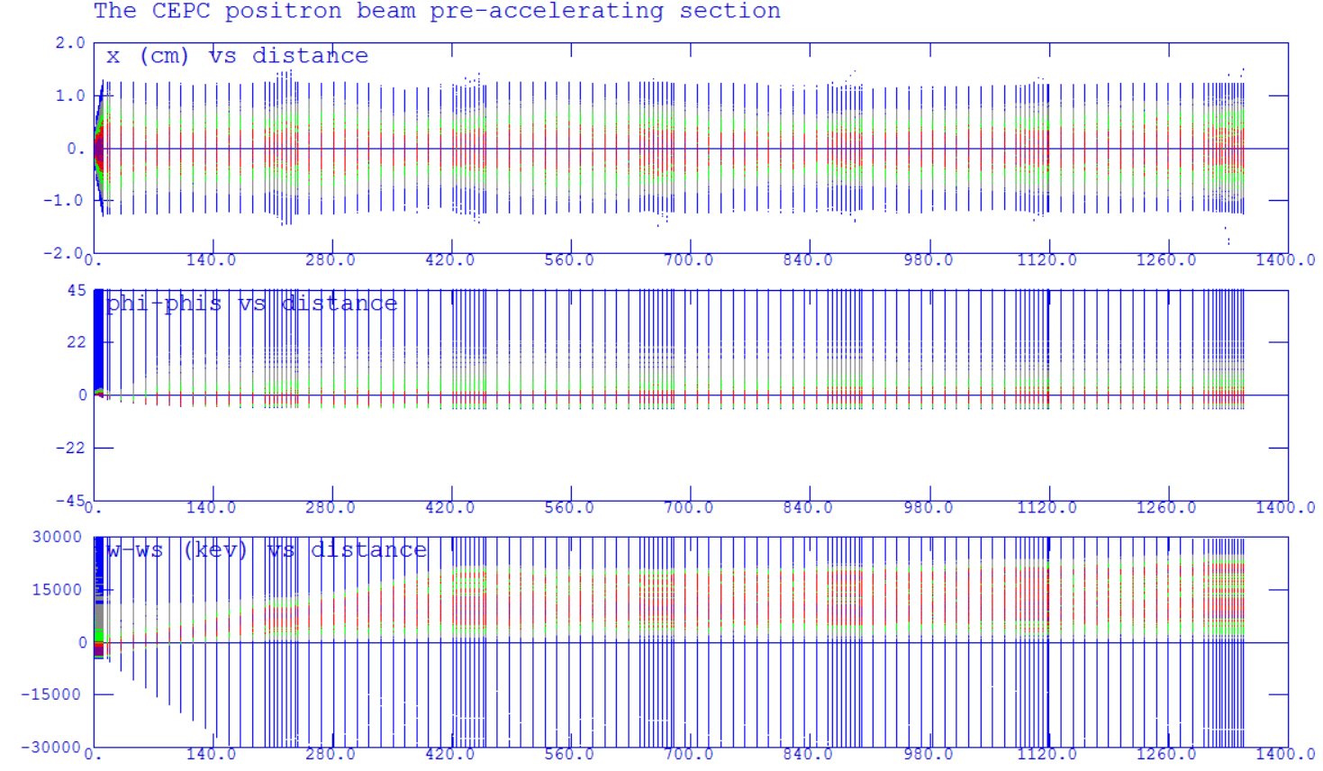
CEPC linac design
Positron linac (Source)
  Norm. RMS. Emittance is about 2500 mm-mrad
  Energy: >200 MeV
  Positron yield
    Ne+/Ne- ~=0.55
    [-8°,12°,235 MeV,265 MeV]
X
Phase
Energy

Slide 20
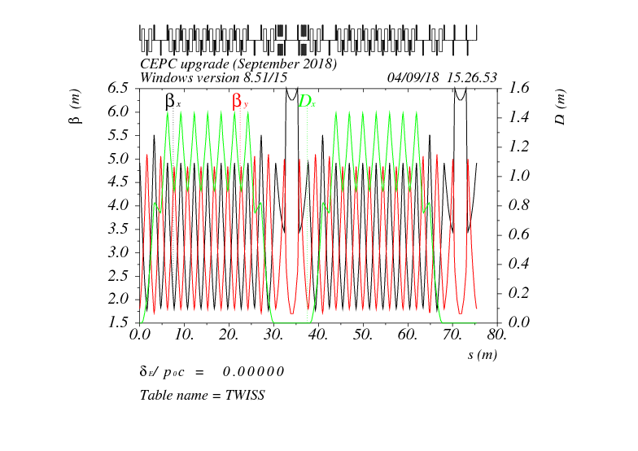
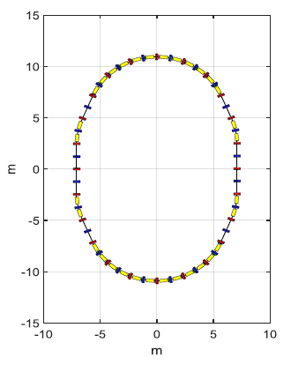
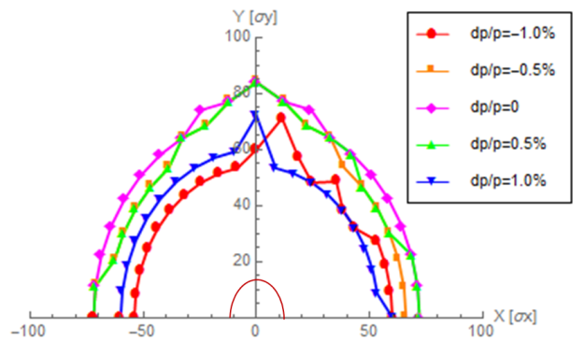
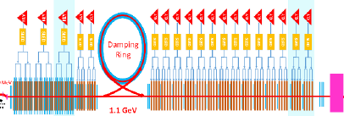
CEPC linac design
Positron linac (Damping ring)
D, Wang
DR V2.0 | Unit | Value
Energy | GeV | 1.1
Circumference | m | 75.4
Storage time | ms | 20
Bending radius | M | 3.565
Dipole strength B₀ | T | 1.03
U₀ | keV | 36.3
Damping time x/y/z | ms | 15.2/15.2/7.6
δ₀ | % | 0.05
ε₀ | mm.mrad | 376.7
σ_{z，inj} | mm | 5.0
Nature σ_{z} | mm | 7.5
ε_{inj} | mm.mrad | 2500
ε_{ext x/y} | mm.mrad | 530/180
δ_{inj} /δ_{ext} | % | 0.2/0.05
Energy acceptance by RF | % | 1.0
f_{RF} | MHz | 650
V_{RF} | MV | 2.0

Slide 21
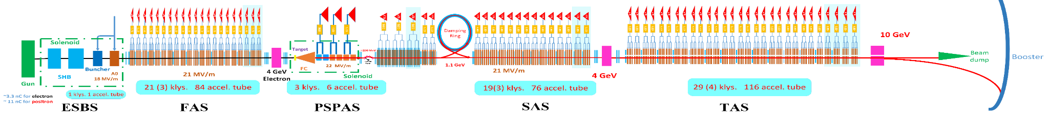
CEPC linac design
Positron linac
  10 Gev with 3 nC charge
  Energy spread (rms): 0.16%
  Emittance with DR (rms): 30(H)/10nm(V)

Slide 22
Outline
1
CEPC layout
2
CEPC linac design
3
CEPC linac key technologies development
4
Summary

Slide 23
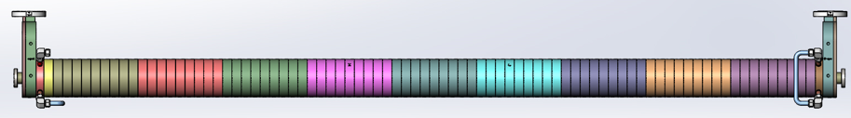
CEPC linac key technologies development
S-band accelerating structure
Flux concentrator

Slide 24
CEPC linac key technologies development
S-band accelerating structure design
  Motivation: The total energy of the main Linac is 14 GeV.
  Goal: For the 3 meters long accelerating structure, about 30 MV/m@1μS (without beam) is expected.

Slide 25
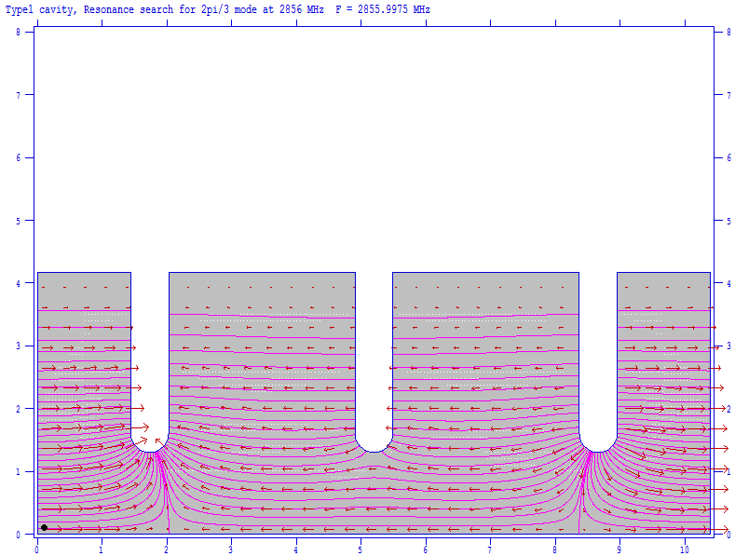
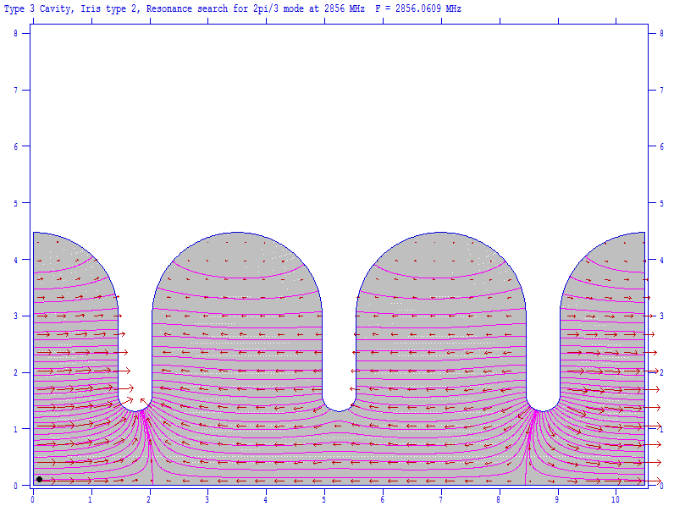
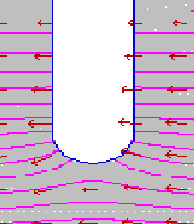
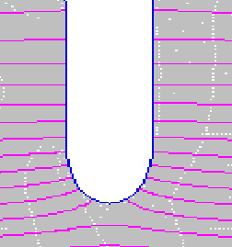
CEPC linac key technologies development
S-band accelerating structure design
  Cavity shape optimization
    Superfish is used to optimize the single cell.
    Rounding the cell improves the quality factor by >12% and reduces the wall power consumption. At the same time, the shunt impedance increases by ~10.9%.
    Irises with elliptical shape (r2/r1=1.8) can reduce the peak surface field by 13%.
Disc-loaded cavity
Rounding shape

Slide 26
CEPC linac key technologies development
S-band accelerating structure design
75MV

Slide 27
CEPC linac key technologies development
S-band accelerating structure design
Parameters | Values | Unit
No. of Cells | 84+2*0.5 | -
Phase advance | 2π/3 | rad
Total length | 3.1 | m
Length of cell (d) | 34.988 | mm
Disk thickness (t) | 5.5 | mm
Shunt impedance (Rs) | 60.3~67.8 | MΩ/m
Quality factor | 15465~15373 | -
Group velocity: Vg/c (%) | 2% ~ 0.94% | -
Filling time (t_{f} ) | 784 | ns
Attenuation factor (τ) | 0.46 | Np

Slide 28
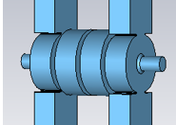
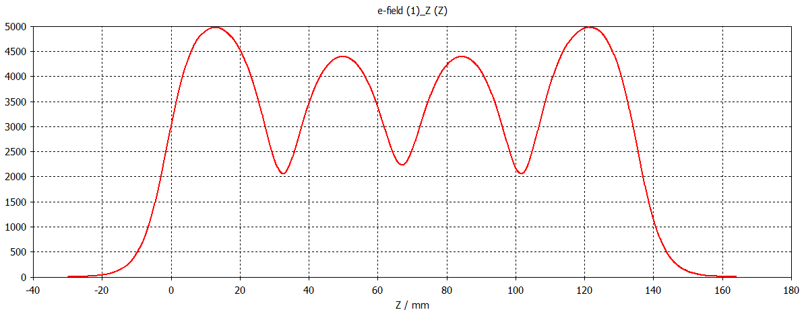
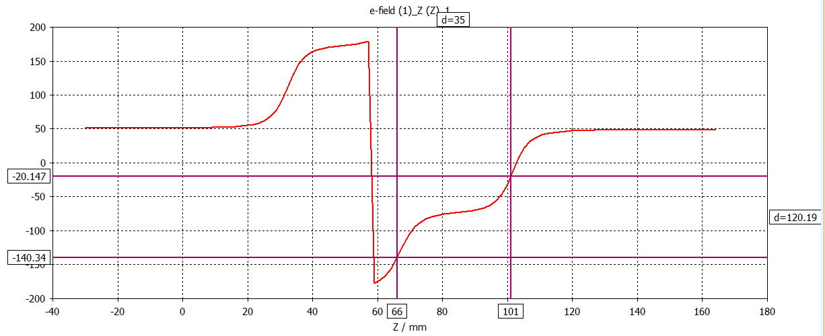

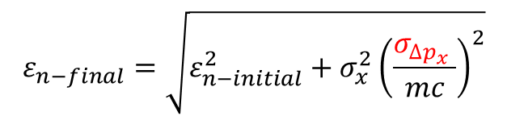
CEPC linac key technologies development
S-band accelerating structure design
  Coupler design
    The asymmetry of the coupling cavity will cause emittance growth.
    The shape of the coupling cavity is racetrack dual-feed type.
    Kyhl method is used to match the coupler.
The calculation model
$$ε_{n−final}=\sqrt{ε_{n−initial}^{2}+σ_{x}^{2}{\left(\frac{σ_{∆p_{x }}}{mc}\right)}^{2}}$$
The distribution of the electric field on axis
$∆p_{x }$=-$\frac{e∆zE_{0}}{2ωa}$[$∆θ∗sinφ−\frac{∆E}{E_{0}}$cos$φ]$
Phase advance per cell

Slide 29
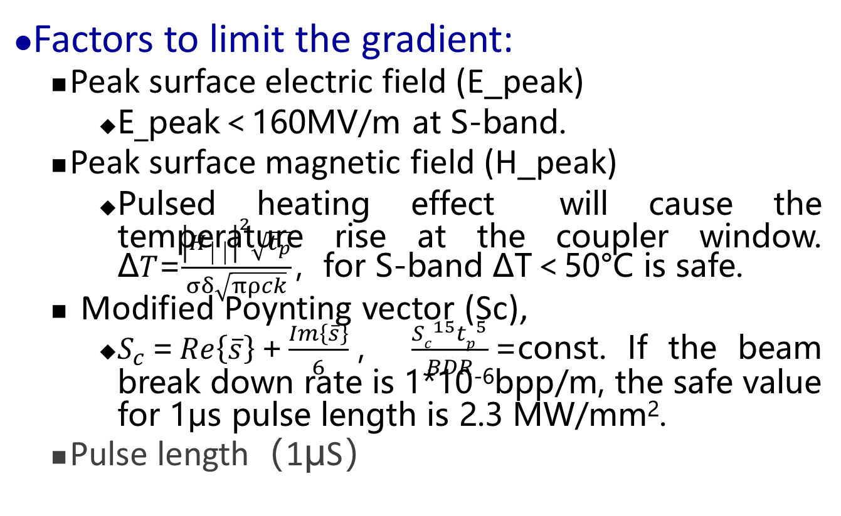
CEPC linac key technologies development
Factors to limit the gradient:
  Peak surface electric field (E_peak)
    E_peak＜160MV/m at S-band.
  Peak surface magnetic field (H_peak)
    Pulsed heating effect will cause the temperature rise at the coupler window. Δ𝑇=$\frac{{\left|H_{││}\right|}^{2}\sqrt{t_{p}}}{σδ\sqrt{πρck}}$，for S-band ΔT＜50°C is safe.
  Modified Poynting vector (Sc),
    $S_{c}$=$Re\left\{\overline{s}\right\}$+$\frac{Im\left\{\overline{s}\right\}}{6}$， $\frac{{Sc}^{15}{tp}^{5}}{BDR}$=const. If the beam break down rate is 1*10⁻⁶bpp/m, the safe value for 1μs pulse length is 2.3 MW/mm².
  Pulse length（1μS）

Slide 30
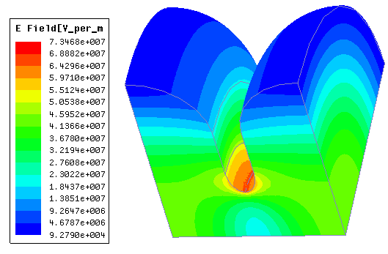
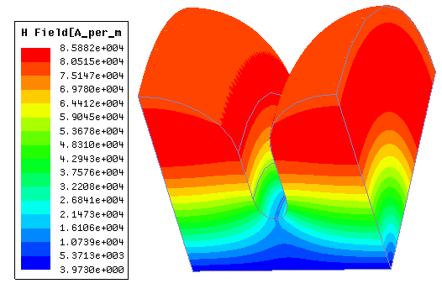
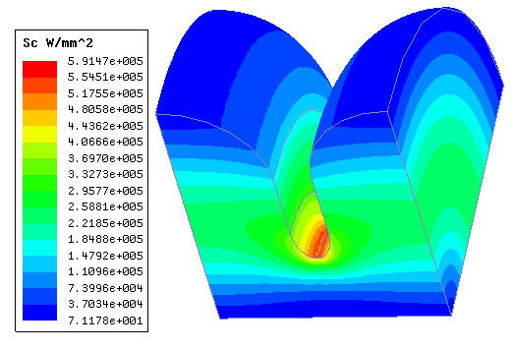
CEPC linac key technologies development
Factors to limit the gradient:
  3D program HFSS is used to confirm the design.
  The 1st cell adjacent the input coupler is simulated for Pin=75 MW.
  The values are safe. Both E_peak and Sc locates at the iris area.
E_peak=73 MV/m.
H_peak=86 kA/m.
Sc_max=0.59 MW/mm².
Surface electric field
Surface magnetic field
Modified Poynting vector

Slide 31
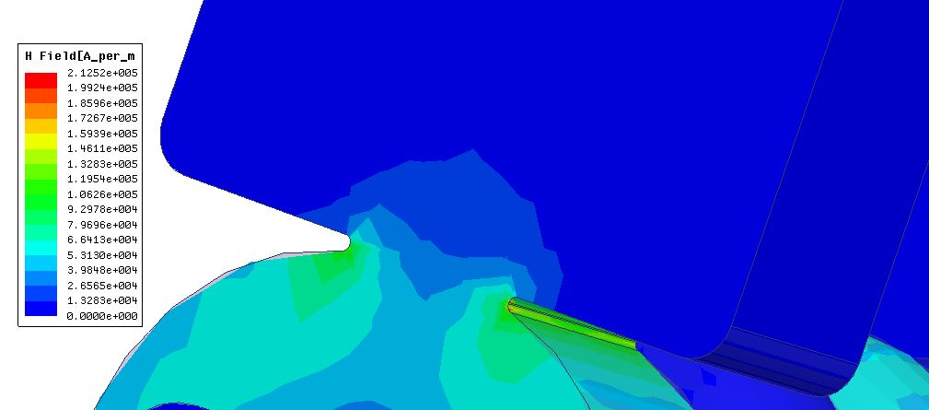
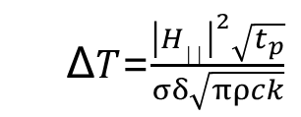


CEPC linac key technologies development
Factors to limit the gradient:
  To reduce the pulsed heating, the coupler window edge is rounded.
  For S-band copper:
  For 75 MW input power, the maximum value of the peak surface magnetic field is 2.1*105 A/m. for 1μS pulse length, $\text{Δ}\text{T}$=9.4⁰C.
$\text{Δ}\text{T}$[⁰c]=127${\left|H_{││}[MA/m]\right|}^{2}\sqrt{{f.\left[GHz\right].t}_{p}[uS]}$
Magnetic field
RF Pulse length
Δ𝑇=$\frac{{\left|H_{││}\right|}^{2}\sqrt{t_{p}}}{σδ\sqrt{πρck}}$
Electric conductivity
Thermal conductivity
Skin depth
Specific heat
Material density

Slide 32
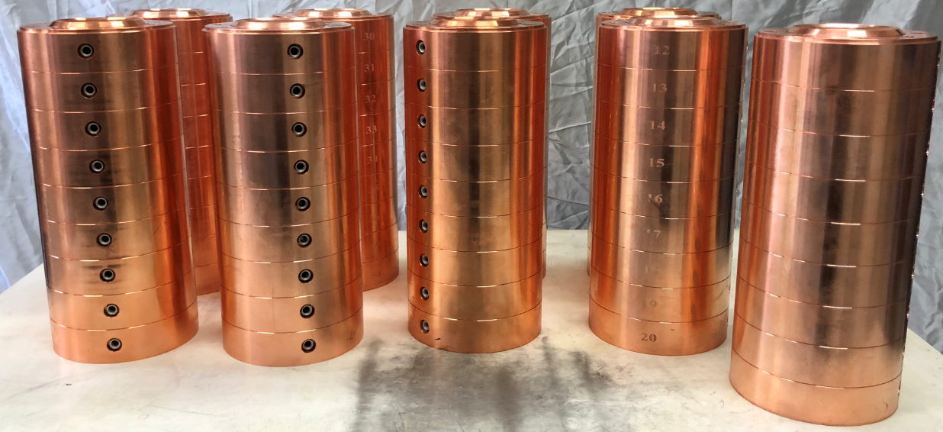
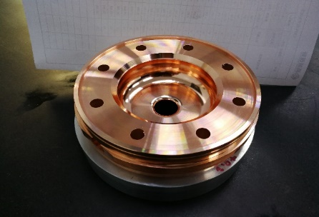
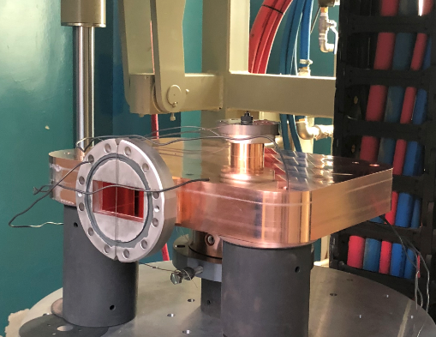
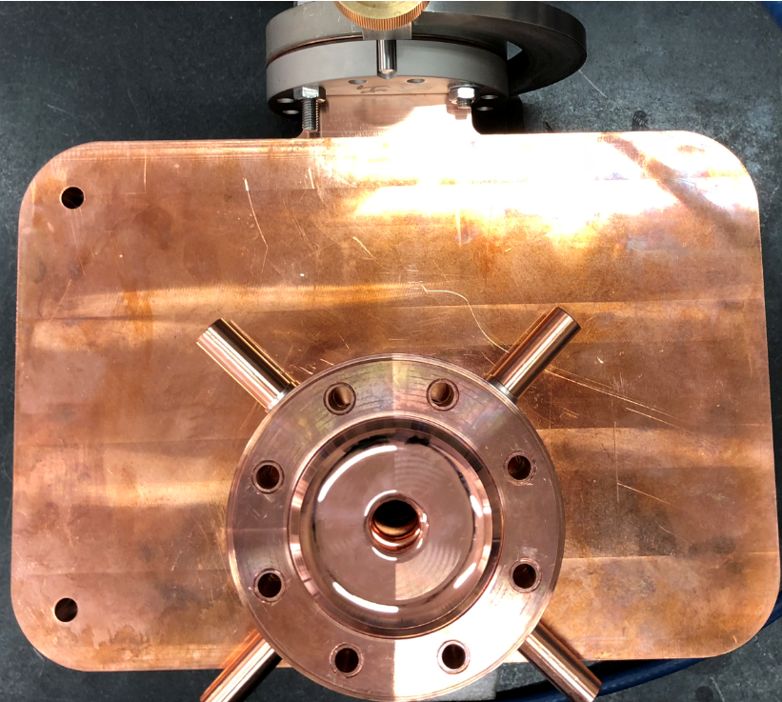
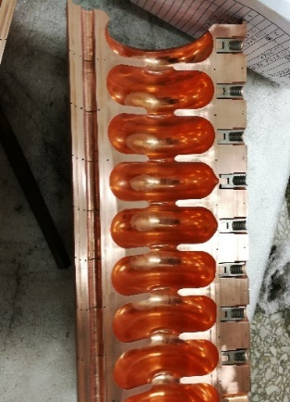
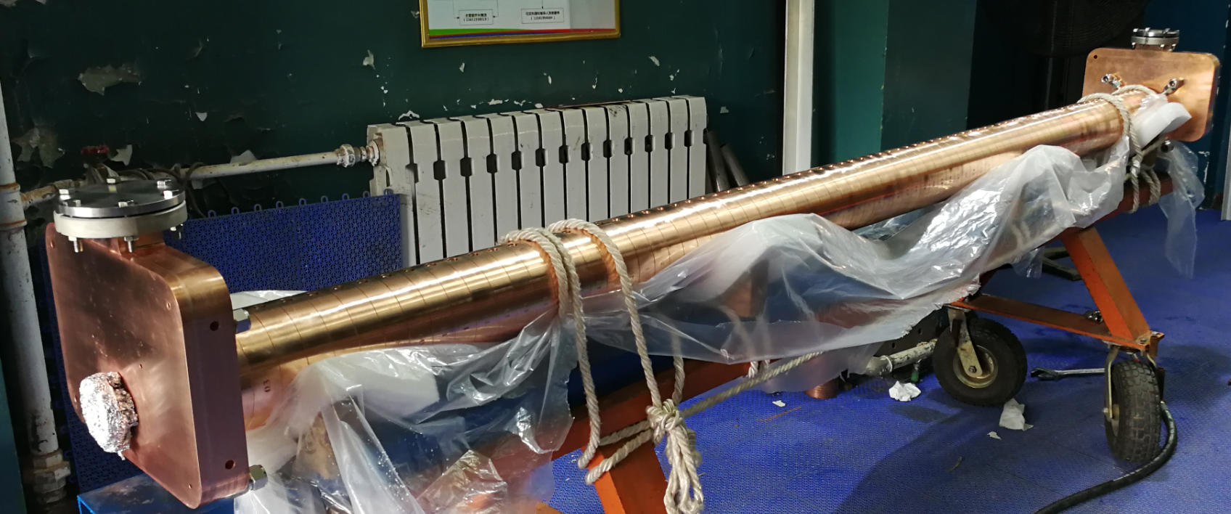
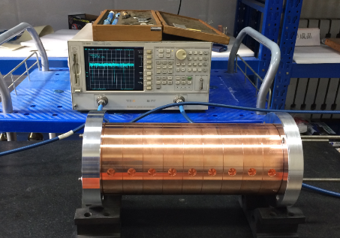
CEPC linac key technologies development
S-band accelerating structure design
  Mechanical design
    Inner water-cooling has been adopted. 8 pipes are around the cavity.
    Compact coupler arrangements. The splitter is milling together with the coupling cavity.
    Two tuners are outside the cavity.

Slide 33
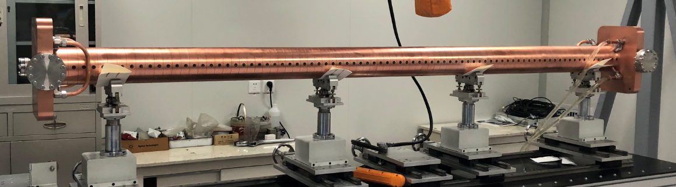
CEPC linac key technologies development
Mechanical design
Accelerating structure under cold test

Slide 34
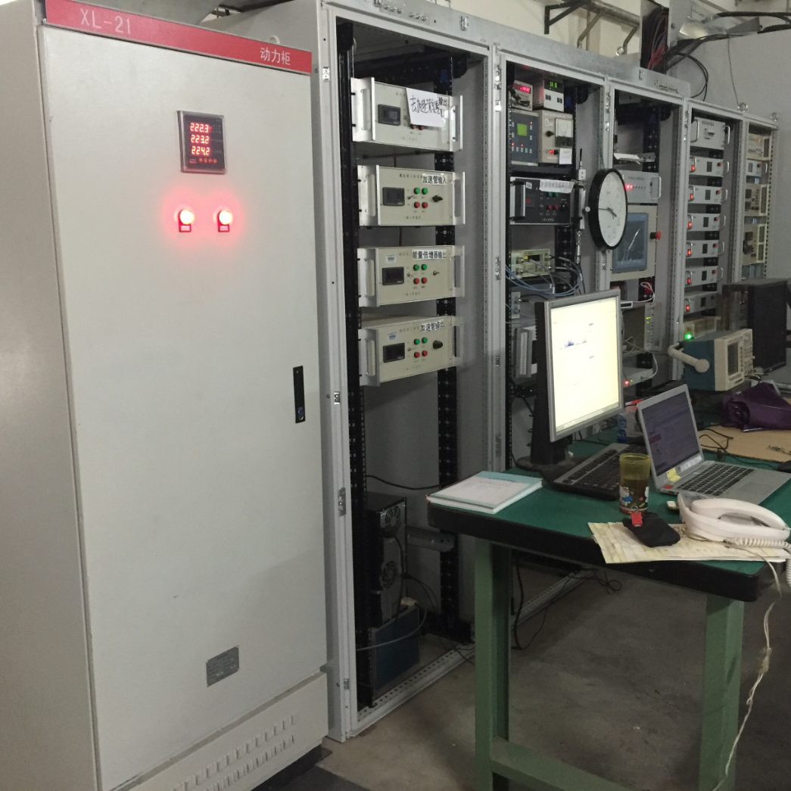
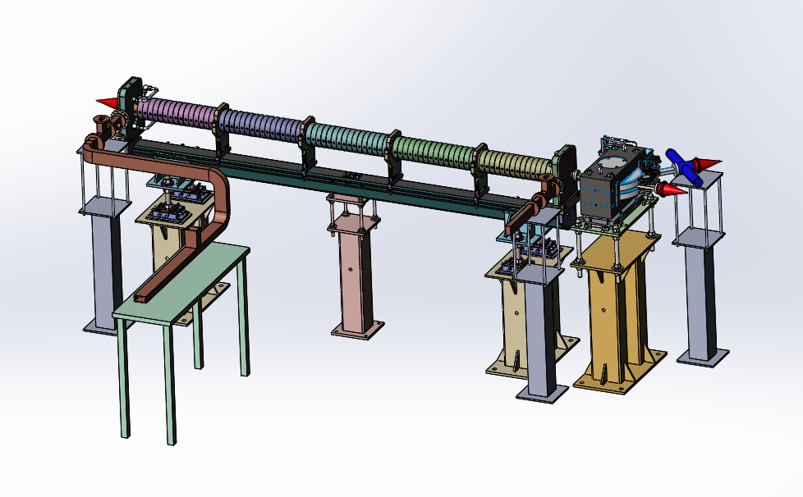
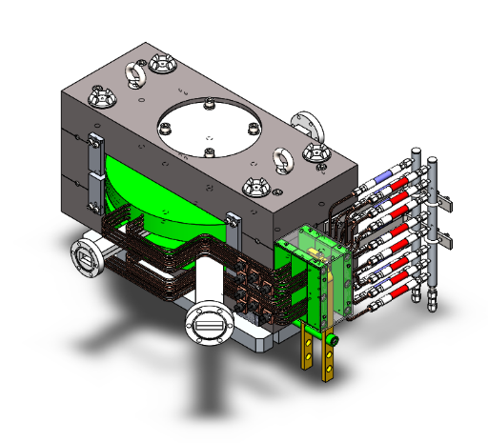
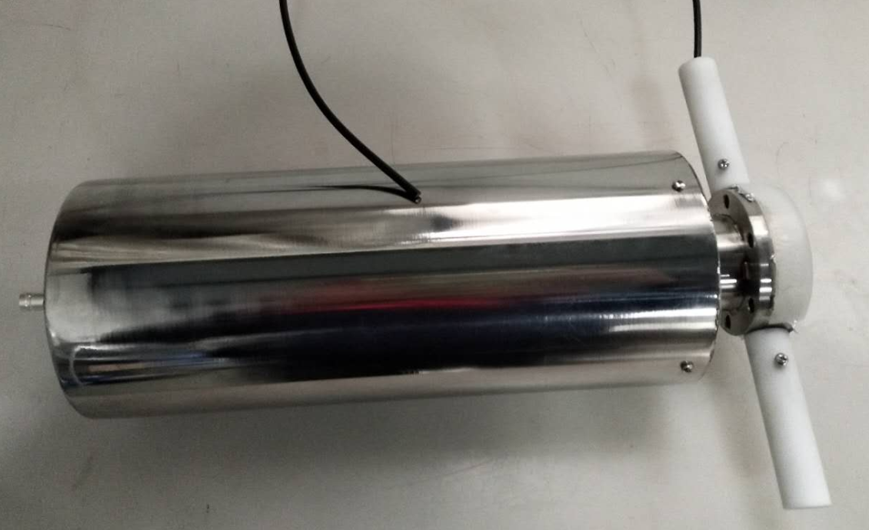
CEPC linac key technologies development
S-band accelerating structure design
  High power test bench
    The power source is available at IHEP.
    The faraday cup and magnet has been designed in order to diagnostic the dark current.
    The high power test will begin recently.
Modulator and klystron
Test bench upgrade
Analyzing Magnet
Faraday Cup

Slide 35
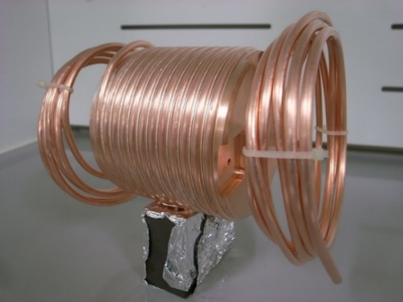

CEPC linac key technologies development
Flux concentrator design
  The FLUX concentrator produces a pulsed magnetic field of 6 T to 0.5 T and It is difficult to machining.
  An MOU was signed with KEK to assist us in the spiral wire cutting process.
The mechanical design of FLUX concentrator
The finished FLUX concentrator
The test bench of the FLUX concentrator

Slide 36


CEPC linac key technologies development
Flux concentrator design
  solid-state pulsed power generator
    The maximum output value is 15 kA / 15 kV / 5 μs;
    Solid state IGCT discharge switch module is used;
    The 10 kA output power has tested successfully;
    Full output power 15 kA will be tested in the near future.
Parameters | Value | Unit
Peak pulse current | ≥15 | kA
Pulse width (bottom width) | 5±0.5 | us
Pulse waveform | Half sine wave | -
Repetition frequency | 50 | Hz
Long term stability | ±0.5% | -
Peak voltage of charging | 15 | kV
The type of discharge switch | IGCT | -
solid-state pulsed power generator
The output of 10kA measurement

Slide 37
Summary
The linac provides 10 GeV electron and positron beam with single bunch mode to the Booster.
A bypass section has been designed for the e- to make the e+ target simple.
A fixed tungsten target is used in the positron source system. The e- beam on the target is 4 GeV & 10 nC.
A damping ring is in the position of 1.1 GeV to reduce the positron emittance.
An S-band accelerating structure and A FLUX concentrator are designed and fabricated. The prototypes are under test.

Slide 38
Thank you for your attention!

